Slide 1
Software Engineering
For non-profit educational use only
May be reproduced ONLY for student use at the university level when used in conjunction
with Software Engineering: A Practitioner's Approach, 7/e. Any other reproduction or use is
prohibited without the express written permission of the author.
These slides are designed to accompany Software Engineering: A Practitioner’s Approach, 7/e
(McGraw-Hill 2009). Slides copyright 2009 by Roger Pressman.
Some of the slides are taken from Sommerville, I., Software Engineering, Pearson Education, 9th Ed., 2010. Those are explicitly indicated

Slide 2
What is Software?
1) instructions (programs) that when executed provide desired function and performance
2) data structures that enable the programs to adequately manipulate information
3) documents that describe the operation and use of the programs
A logical rather than physical system element
SS ZG562 - Software Engineering & Management

Slide 3
Engineering vs. Science
“A scientist builds in order to learn; an engineer learns in order to build.” — Fred Brooks
Scientists learn what is true, how to test hypotheses, and how to extend knowledge in their field. Engineers learn what is true, what is useful, and how to apply well-understood knowledge to solve practical problems.
“Professional Software Development: Shorter Schedules, Better Projects, Superior Products, Enhanced Careers” Steve McConnell Addison-Wesley
SS ZG562 - Software Engineering & Management

Slide 4
Dual Role of Software
Both a product and a vehicle for delivering a product
Product
Delivers computing potential
Produces, manages, acquires, modifies, display, or transmits information
Vehicle
Supports or directly provides system functionality
Controls other programs (e.g., operating systems)
Effects communications (e.g., networking software)
Helps build other software (e.g., software tools)
SS ZG562 - Software Engineering & Management

Slide 5
Software Products
Generic products
Stand-alone systems which are produced by a development organization and sold on the open market to any customer
The specification of what the software should do is owned by the software developer and decisions on software change are made by the developer.
Examples – PC software such as word processor, project management tools; CAD software; software for specific markets such as appointments systems for dentists.
Bespoke (customized) products
Systems which are commissioned by a specific customer and developed specially by some Contractor
The specification of what the software should do is owned by the customer for the software and they make decisions on software changes that are required.
Examples –e-commerce application of an organization, embedded software for anti-lock braking systems.
Most software expenditure is on generic products but most development effort is on bespoke systems
SS ZG562 - Software Engineering & Management

Slide 6
Software Applications
System software
Compiler, Operating System…
Application software
Railway reservation…
Engineering/scientific Software
Astronomy, automated manufacturing…
Embedded software
Braking system, Mobile phone…
SS ZG562 - Software Engineering & Management

Slide 7
Software Applications (contd)
Product-line software
Word processor, personal finance application…
WebApps (Web applications)
Social networks…
AI software
Pattern recognition, neural networks…
SS ZG562 - Software Engineering & Management

Slide 8
Software—New Categories
Open world computing - pervasive, distributed Computing
Netsourcing - the Web as a computing engine
Open source - ”free” source code open to the computing community (a blessing, but also a potential curse!)
Also …
Data mining
Grid computing
Cognitive machines
Software for nanotechnologies
SS ZG562 - Software Engineering & Management

Slide 9
Software Characteristics
Software is developed or engineered....Not manufactured in the classical sense
Software does NOT “wear out”
Aging of software is very unlike material objects (hardware)
Industry is moving towards component-based construction, but most of the software effort is for the custom-building
SS ZG562 - Software Engineering & Management

Slide 10
Failure (“Bathtub”) Curve for Hardware
Infant
mortality
Failure Rate
Wear
out
Time
SS ZG562 - Software Engineering & Management

Slide 11
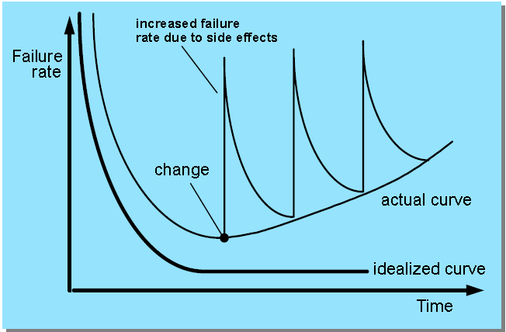
Software Deterioration
SS ZG562 - Software Engineering & Management

Slide 12
Evolving the Legacy Software
(Adaptive) Must be adapted to meet the needs of new computing environments or more modern systems, databases, or networks
(Perfective) Must be enhanced to implement new business requirements , improve performance etc.
(Corrective) Must be changed because of errors found in the specification, design, or implementation
(Note: These are three major reasons for software maintenance, along with Preventive maintenence)
SS ZG562 - Software Engineering & Management

Slide 13
Characteristics of WebApps (1/2)
Network intensiveness. A WebApp resides on a network and must serve the needs of a diverse community of clients.
Concurrency. A large number of users may access the WebApp at one time.
Unpredictable load. The number of users of the WebApp may vary by orders of magnitude from day to day.
Performance. If a WebApp user must wait too long (for access, for server-side processing, for client-side formatting and display), he or she may decide to go elsewhere.
Availability. Although expectation of 100 percent availability is unreasonable, users of popular WebApps often demand access on a “24/7/365” basis.
Data driven. The primary function of many WebApps is to use hypermedia to present text, graphics, audio, and video content to the end-user.
SS ZG562 - Software Engineering & Management

Slide 14
Characteristics of WebApps (2/2)
Content sensitive. The quality and aesthetic nature of content remains an important determinant of the quality of a WebApp
Continuous evolution. Unlike conventional application software that evolves over a series of planned, chronologically-spaced releases, Web applications evolve continuously
Immediacy. Although immediacy—the compelling need to get software to market quickly—is a characteristic of many application domains, WebApps often exhibit a time to market that can be a matter of a few days or weeks
Security. Because WebApps are available via network access, it is difficult, if not impossible, to limit the population of end-users who may access the application
Aesthetics. An undeniable part of the appeal of a WebApp is its look and feel
SS ZG562 - Software Engineering & Management

Slide 15
Questions About Software Haven't Changed Over the Decades
Why does it take so long to get software finished?
Why are development costs so high?
Why can't we find all errors before we give the software to our customers?
Why do we spend so much time and effort maintaining existing programs?
Why do we continue to have difficulty in measuring progress as software is being developed and maintained?
SS ZG562 - Software Engineering & Management

Slide 16
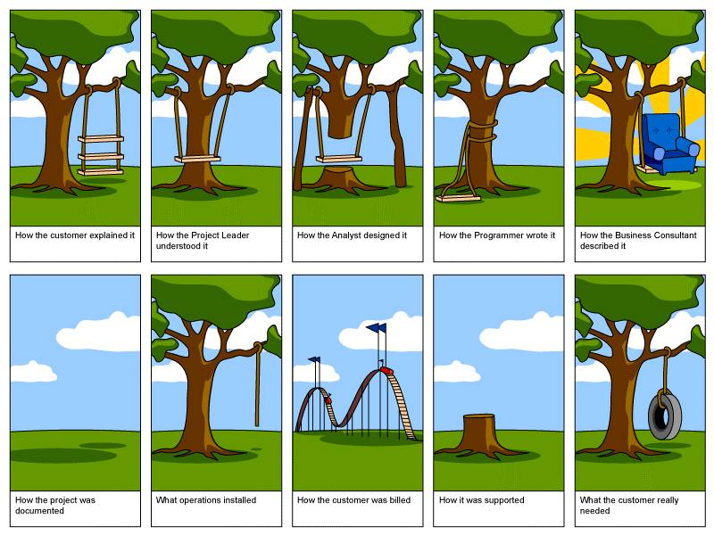
Extreme Views on Software Engineers (No shortage of jokes on software engineers)
SS ZG562 - Software Engineering & Management

Slide 17
Software Myths - Management
"We already have a book that is full of standards and procedures for building software. Won't that provide my people with everything they need to know?"
Not used, not up to date, not complete, not focused on quality, time, and money
"If we get behind, we can add more programmers and catch up"
Adding people to a late software project makes it later
Training time, increased communication lines
"If I decide to outsource the software project to a third party, I can just relax and let that firm build it"
Software projects need to be controlled and managed
SS ZG562 - Software Engineering & Management
17

Slide 18
Software Myths - Customer
"A general statement of objectives is sufficient to begin writing programs – we can fill in the details later"
Ambiguous statement of objectives spells disaster
"Project requirements continually change, but change can be easily accommodated because software is flexible"
Impact of change depends on where and when it occurs in the software life cycle (requirements analysis, design, code, test)
SS ZG562 - Software Engineering & Management

Slide 19
The Cost of Change
SS ZG562 - Software Engineering & Management

Slide 20
Software Myths - Practitioner
"Once we write the program and get it to work, our job is done"
60% to 80% of all effort expended on software occurs after it is delivered
"Until I get the program running, I have no way of assessing its quality
Formal technical reviews of requirements analysis documents, design documents, and source code (more effective than actual testing)
"The only deliverable work product for a successful project is the working program"
Software, documentation, test drivers, test results
"Software engineering will make us create voluminous and unnecessary documentation and will invariably slow us down"
Creates quality, not documents; quality reduces rework and provides software on time and within the budget
SS ZG562 - Software Engineering & Management

Slide 21
Software Engineering - Definitions
(1969 – Fritz Bauer) Software engineering is the establishment and use of sound engineering principles in order to obtain economically software that is reliable and works efficiently on real machines
Some may want to have technical aspects, customer satisfaction, timeliness, measurements, process included in the definition
(IEEE) The application of a systematic, disciplined, quantifiable approach to the development, operation, and maintenance of software; that is, the application of engineering to software
Some may consider adaptability and agility more important than systematic, disciplined, quantifiable approach
SS ZG562 - Software Engineering & Management

Slide 22
A Layered Technology
Software Engineering
tools
methods
process model
a “quality” focus
SS ZG562 - Software Engineering & Management

Slide 23
Process, Methods, and Tools
Process
Provides the glue that holds the layers together; enables rational and timely development; provides a framework for effective delivery of technology; forms the basis for management; provides the context for technical methods, work products, milestones, quality measures, and change management
Methods
Provide the technical "how to" for building software; rely on a set of basic principles; encompass a broad array of tasks; include modeling activities
Tools
Provide automated or semi-automated support for the process and methods (i.e., CASE tools)
SS ZG562 - Software Engineering & Management

Slide 24
A Process Framework
Software Process
Process framework
Process framework
Framework activities
work tasks
work products
milestones & deliverables
QA checkpoints
Umbrella Activities
Framework activity 1
Framework activity n
Umbrella Activities
SS ZG562 - Software Engineering & Management
24

Slide 25
A Process Framework
Process framework
Modeling activity
Software Engineering action: Analysis
work tasks: requirements gathering,
elaboration, negotiation,
specification, validation
work products: analysis model and/or
requirements specification
milestones & deliverables
QA checkpoints
Software Engineering action: Design
work tasks: data design, architectural,
interface design,
component design
work products: design model
and/or design specification
Umbrella Activities
Process framework
Framework activities
work tasks
work products
milestones & deliverables
QA checkpoints
Umbrella Activities
SS ZG562 - Software Engineering & Management
25

Slide 26
Framework Activities
Communication
Involves communication among the customer and other stake holders; encompasses requirements gathering
Planning
Establishes a plan for software engineering work; addresses technical tasks, resources, work products, and work schedule
Modeling (Analyze, Design)
Encompasses the creation of models to better understand the requirements and the design
Construction (Code, Test)
Combines code generation and testing to uncover errors
Deployment
Involves delivery of software to the customer for evaluation and feedback
SS ZG562 - Software Engineering & Management

Slide 27
Umbrella Activities
Software project tracking and control
Assess progress against the plan
Software quality assurance
Activities required to ensure quality
Software configuration management
Manage effects of change
Technical Reviews
Uncover errors before going to next activity
Formal technical reviews
Assess work products to uncover errors
SS ZG562 - Software Engineering & Management

Slide 28
Umbrella Activities (contd)
Risk management
Assess risks that may affect quality
Measurement – process, project, product
Reusability management (component reuse)
Work product preparation and production
Models, documents, logs, forms, lists…
etc.
SS ZG562 - Software Engineering & Management

Slide 29
How Process Models Differ?
While all Process Models take same framework and umbrella activities, they differ with regard to
Overall flow of activities, actions, and tasks and the interdependencies among them
Degree to which actions and tasks are defined within each framework activity
Degree to which work products are identified and required
Manner in which quality assurance activities are applied
Manner in which project tracking and control activities are applied
Overall degree of detail and rigor with which the process is described
Degree to which customer and other stakeholders are involved in the project
Level of autonomy given to the software team
Degree to which team organization and roles are prescribed
SS ZG562 - Software Engineering & Management

Slide 30
Process Patterns
A proven solution to a problem
Describes process-related problem
Environment in which it was encountered
A template to describe solution
Ambler proposed a template for describing a process pattern
Can be defined at any level of abstraction
Complete process model (e.g. Prototyping)
Frame work activity (e.g. Planning)
An action within framework activity (e.g. Estimation)
SS ZG562 - Software Engineering & Management

Slide 31
Process Patterns – Ambler’s Template
Pattern Name
Forces
Describes environment of the problem
Type
Phase (e.g. Prototyping), Stage (e.g. Planning), or Task (e.g. Estimation)
Initial Context
Problem
Solution
Resulting Context
Related Patterns
Known uses & examples
SS ZG562 - Software Engineering & Management

Slide 32
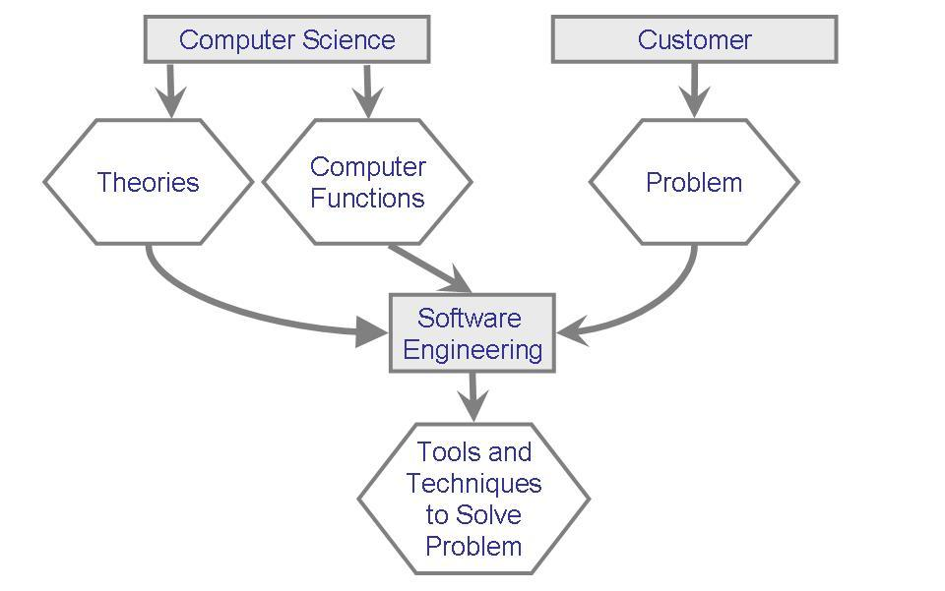
Software Engineering Context
Pfleeger and Atlee, Software Engineering: Theory and Practice, 4th Ed, Pearson 2009
SS ZG562 - Software Engineering & Management

Slide 33
Software engineering (as per author Sommerville)
Software engineering is an engineering discipline that is concerned with all aspects of software production from the early stages of system specification through to maintaining the system after it has gone into use.
Engineering discipline
Using appropriate theories and methods to solve problems bearing in mind organizational and financial constraints.
All aspects of software production
Not just technical process of development. Also project management and the development of tools, methods etc. to support software production.
July 25, 2014
SS ZG562 - Software Engineering & Management
33

Slide 34
FAQs Answered by author Sommerville
Question | Answer
What is software? | Computer programs and associated documentation. Software products may be developed for a particular customer or may be developed for a general market.
What are the attributes of good software? | Good software should deliver the required functionality and performance to the user and should be maintainable, dependable and usable.
What is software engineering? | Software engineering is an engineering discipline that is concerned with all aspects of software production.
What are the fundamental software engineering activities? | Software specification, software development, software validation and software evolution.
What is the difference between software engineering and computer science? | Computer science focuses on theory and fundamentals; software engineering is concerned with the practicalities of developing and delivering useful software.
What is the difference between software engineering and system engineering? | System engineering is concerned with all aspects of computer-based systems development including hardware, software and process engineering. Software engineering is part of this more general process.
July 25, 2014
SS ZG562 - Software Engineering & Management
34

Slide 35
Attributes of good software by author Sommerville
Product characteristic | Description
Maintainability | Software should be written in such a way so that it can evolve to meet the changing needs of customers. This is a critical attribute because software change is an inevitable requirement of a changing business environment.
Dependability and security | Software dependability includes a range of characteristics including reliability, security and safety. Dependable software should not cause physical or economic damage in the event of system failure. Malicious users should not be able to access or damage the system.
Efficiency | Software should not make wasteful use of system resources such as memory and processor cycles. Efficiency therefore includes responsiveness, processing time, memory utilisation, etc.
Acceptability | Software must be acceptable to the type of users for which it is designed. This means that it must be understandable, usable and compatible with other systems that they use.
July 25, 2014
SS ZG562 - Software Engineering & Management
35

Slide 36
The software process (as per Somerville)
A structured set of activities required to develop a software system.
Many different software processes but all involve:
Specification – defining what the system should do;
Design and implementation – defining the organization of the system and implementing the system;
Validation – checking that it does what the customer wants;
Evolution – changing the system in response to changing customer needs.
A software process model is an abstract representation of a process. It presents a description of a process from some particular perspective.
July 25, 2014
SS ZG562 - Software Engineering & Management
36

Slide 37
The Essence of Problem Solving (as Per George Polya – A Hungarian Mathematician)
Understand the problem
What are the unknowns?
Can the problem be compartmentalized?
Can the problem be represented graphically?
Plan a solution
Have you seen similar problems like this before?
Has a similar problem been solved and is the solution reusable?
Can subproblems be defined and solved?
Carry out the plan
Is the solution as per plan?
Is each component of the solution correct?
Examine the results for accuracy
Is it possible to test each component of the solution?
SS ZG562 - Software Engineering & Management

Slide 38
The Essence of Problem Solving (in Software Engineering)
Understand the problem (communication and analysis)
Who has a stake in the solution to the problem?
What are the unknowns (data, function, behavior)?
Can the problem be compartmentalized?
Can the problem be represented graphically?
Plan a solution (planning, modeling and software design)
Have you seen similar problems like this before?
Has a similar problem been solved and is the solution reusable?
Can subproblems be defined and solved?
Carry out the plan (construction; code generation)
Is the solution as per plan? Is the source code traceable to the design?
Is each component of the solution correct? Has the design and code been reviewed?
Examine the results for accuracy (testing and quality assurance)
Is it possible to test each component of the solution?
Does the solution produce results that conform to the data, function, and behavior that are required?
SS ZG562 - Software Engineering & Management

Slide 39
Seven Core Principles for Software Engineering (David Hooker – 1996)
Remember the reason that the software exists
The software should provide value to its users and satisfy the requirements
Keep it simple, stupid (KISS)
All design and implementation should be as simple as possible
Maintain the vision of the project
A clear vision is essential to the project’s success
Others will consume what you produce
Always specify, design, and implement knowing that someone else will later have to understand and modify what you did
Be open to the future
Never design yourself into a corner; build software that can be easily changed and adapted
Plan ahead for software reuse
Reuse of software reduces the long-term cost and increases the value of the program and the reusable components
Think, then act
Placing clear, complete thought before action will almost always produce better results
SS ZG562 - Software Engineering & Management

Slide 40
What Lies Ahead?
Some trends that will exacerbate Hardware-software-human factors integration problems are
Complex, multi-owner systems of systems. Current collections of incompatible, separately-developed systems will cause numerous challenges.
Emergent requirements. Demands for most appropriate user interfaces and collaboration modes for a complex human-intensive system.
Rapid change. Specifying current-point-in-time snapshot requirements on a cost-competitive contract generally leads to a big design up front, and a point-solution architecture that is hard to adapt to new developments.
Reused components. Reuse-based development has major bottom-up development implications, and is incompatible with pure top-down requirements-first approaches.
High assurance of qualities. Future systems will need higher assurance levels of such qualities as safety, security, reliability/availability/maintainability, performance, adaptability, interoperability, usability, and scalability.
July 25, 2014
SS ZG562 - Software Engineering & Management
40

Slide 41
Another perspective of SE: Do we stand on quicksand or the shoulders of giants?
Have you ever found that a new method or practice is just the re-branding and regurgitation of old?
Do you find every new idea about software development seems to be at the expense and in aggressive competition with everything that has gone before?
Does it seem to you that following that latest software development trend has become more important than producing great software?
Have you noticed how in their hurry to forge ahead people seem to throw away the good with the bad? It is as though they have no solid knowledge to stand upon.
Many teams carelessly discard expensive process and tool investments, almost before they have even tried them.
Every time someone changes their job they have to learn a new approach before they can get on with the real task at hand. People cannot learn from experience as they are forever starting over.
July 25, 2014
SS ZG562 - Software Engineering & Management
41

Slide 42
Summary
Software is a logical entity
Software is engineered; not manufactured
Software deteriorates in different ways than hardware
Software Engineering could be looked upon as layers of elements
Software Engineering requires framework activities and umbrella activities
Patterns help gain from established solutions
There are many myths associated with software engineering
Software Engineering activities can be mapped to Polya’s scientific approach to solve a problem
David Hooker offers seven valuable software engineering principles
SS ZG562 - Software Engineering & Management

Slide 43
Thank You

